Slide 1
GrANITE RIVER LABS

Slide 2
Programming concepts IN jAVA
Data Types Primitive -
Data Type | Size | Description
byte | 1 byte | Stores whole numbers from -128 to 127
short | 2 bytes | Stores whole numbers from -32,768 to 32,767
int | 4 bytes | Stores whole numbers from -2,147,483,648 to 2,147,483,647
long | 8 bytes | Stores whole numbers from -9,223,372,036,854,775,808 to 9,223,372,036,854,775,807
float | 4 bytes | Stores fractional numbers. Sufficient for storing 6 to 7 decimal digits
double | 8 bytes | Stores fractional numbers. Sufficient for storing 15 decimal digits
boolean | 1 bit | Stores true or false values
char | 2 bytes | Stores a single character/letter or ASCII values
Non Primitive – Strings, Classes, Interfaces, Arrays etc

Slide 3
JAVA THREADS
Threads allows a program to operate more efficiently by doing multiple things at the same time.
Threads can be used to perform complicated tasks in the background without interrupting the main program.
There are two ways to create a thread:
By extending Thread class
By implementing Runnable interface.

Slide 4
Number systems
Binary Number System : Base 2, eg int a=0b1010;
Octal Number System : Base 8, eg int a=033;
Decimal Number System : Base 10, eg int a=123;
Hexadecimal Number System : Base 16, eg int a=0xAB;

Slide 5
Number systems
bit(b) – 0 or 1
Byte(B) – 8 bits
Kilobyte(KB) – 10³
Megabyte(MB) – 10⁶
Gigabyte(GB) - 10⁹
Terabyte(TB) - 10¹²
Petabyte(PB) - 10¹⁵

Slide 6
Oops
Object-Oriented Programming is a methodology or paradigm to design a program using classes and objects.
Object : An Object can be defined as an instance of a class. An object contains an address and takes up some space in memory.
Class : Collection of objects is called class. It is a logical entity, A class can also be defined as a blueprint from which you can create an individual object. Class doesn't consume any space.
interface in Java: It is a blueprint of a class. It has static constants and abstract methods. It is a mechanism to achieve abstraction There can be only abstract methods in the Java interface, not method body. It is used to achieve abstraction and multiple Inheritance in Java.

Slide 7
Inheritance
Inheritance in Java is a mechanism in which one object acquires all the properties and behaviours of a parent object.
The idea behind inheritance in Java is that you can create new classes that are built upon existing classes. When you inherit from an existing class, you can reuse methods and fields of the parent class. Moreover, you can add new methods and fields in your current class also.

Slide 8
Abstraction
Abstraction is a process of hiding the implementation details and showing only functionality to the user.
Another way, it shows only essential things to the user and hides the internal details, for example, sending SMS where you type the text and send the message. You don't know the internal processing about the message delivery.
There are two ways to achieve abstraction in java
Abstract class
Interface

Slide 9
Encapsulation
Encapsulation in Java is a process of wrapping code and data together into a single unit, for example, a capsule which is mixed of several medicines.
We can create a fully encapsulated class in Java by making all the data members of the class private. Now we can use setter and getter methods to set and get the data in it.

Slide 10
Polymorphism
Polymorphism in Java is a concept by which we can perform a single action in different ways. Polymorphism is derived from 2 Greek words: poly and morphs. The word "poly" means many and "morphs" means forms. So polymorphism means many forms.
There are two types of polymorphism in Java: compile-time polymorphism and runtime polymorphism. We can perform polymorphism in java by method overloading and method overriding.

Slide 11
Recursion
Recursion in java is a process in which a method calls itself continuously. A method in java that calls itself is called recursive method.
Syntax:
returntype methodname(){
//code to be executed
methodname();//calling same method
}

Slide 12
Memory management
Stack : It stores items that have a very short life such as methods, variables, and reference variables of the objects.
Heap : It stores objects and Java Runtime Environment (JRE) classes.

Slide 13
Academic project
Secure image transfer using video steganography based on Shi-tomasi corner detection

Slide 14
digital communication basics
Data is transferred in the form of bits between two or more digital devices.
There are two methods used to transmit data between digital devices: serial transmission and parallel transmission.
Serial data transmission sends data bits one after another over a single channel.
Parallel data transmission sends multiple data bits at the same time over multiple channels.

Slide 15
Data rate : The speed at which data is transferred within the computer or between a peripheral device and the computer, measured in bytes per second.
A digital signal is different from its continuous counterpart in two primary ways:
It is sampled at specific time steps.
It is quantized at specific voltage levels.

Slide 16
Clock: It oscillates between a high and a low state and is used like a metronome to coordinate actions of digital circuits.
Frequency: The frequency of a signal voltage is measured in cycles per second. One hertz is one complete cycle per second.
Amplitude: It is the power of a signal. The greater the amplitude, the greater the energy carried.
Peak-to-peak (pk-pk) : It is the difference between the maximum positive and the maximum negative amplitudes of a waveform

Slide 17
Voltage: It is the difference in electric potential between two points. 1 Volt= 1 Joule/coulomb, V= Work done/Charge
Current: the current is the rate at which electric charge flows in a circuit at a particular point. 1 Ampere = 1 coulomb/second, I= Charge/ Time
Power: It is defined as the rate energy is transformed or transferred over time. We measure power in units of joules/second, also known as watts. P = VI
AC/DC: Electric current flows in two ways as an alternating current (AC) or direct current (DC). In alternating current, the current keeps switching directions periodically – forward and backward. While in the direct current it flows in a single direction steadily.
Transformer: It is an electrical device that uses the principle of electromagnetic induction to transfer energy from one electric circuit to another.

Slide 18
Basic parts of computer and it's functions
Processor: also known as the CPU, provides the instructions and processing power the computer needs to do its work.
32 bit/ 64 bit: In computing, there are two types of processors existing. These types of processors tell us how much memory a processor can access from a CPU register.
ARM processor: It is one of a family of central processing units based on the reduced instruction set computer architecture for computer processors. ARM often resides in mobile devices.
Intel : these processors use Complex Instruction Set Computing (CISC) for computer processors. Intel processors are commonly found in larger devices such as desktop computers,

Slide 19
Memory
Volatile memory : It is used to store computer programs and data that CPU needs in real time and is erased once computer is switched off. RAM and Cache memory are volatile memory.
Non-volatile memory: It is static and remains in the computer even if computer is switched off. ROM and HDD are non-volatile memory.

Slide 20
The network card operates as a middleman between a computer and a data network. For example, when a user requests a webpage, the computer will pass the request to the network card, which converts it into electrical impulses.
USB, or Universal Serial Bus is a data interface used with computers enabling the computer to send and receive data as well as providing power to some peripherals like disc drives, Flash memory sticks and the like so that separate power sources are not needed for each item
A display interface is used to transmit video, potentially also audio and other technologies between the signal source (typically a computer, docking station, DVD player etc.) and the display unit (monitor, projector).
HDMI and DisplayPort are two of the most commonly used connectors on displays and media devices.

Slide 21
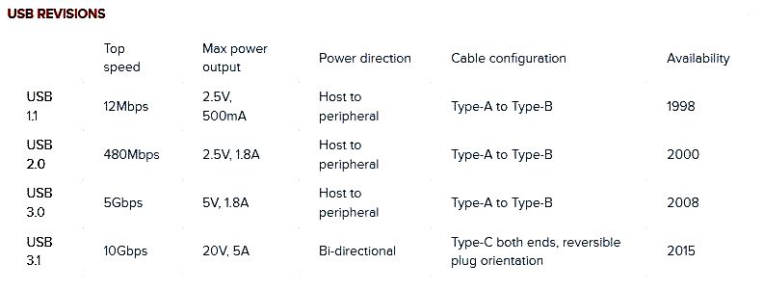
USB interface basics
USB, or Universal Serial Bus is a data interface used with computers enabling the computer to send and receive data as well as providing power to some peripherals like disc drives, Flash memory sticks and the like so that separate power sources are not needed for each item.

Slide 22
OS basics
"An operating system (OS) is software system that manages computer hardware, software resources, and provides common services for computer programs".
In the modern days, when speaking about personal desktop/laptop computers, the three most used operating systems are Microsoft Windows (with around 80% market share), Apple MacOS (with around 15% market share), and GNU/Linux based OSs (with around 3% market share).

Slide 23
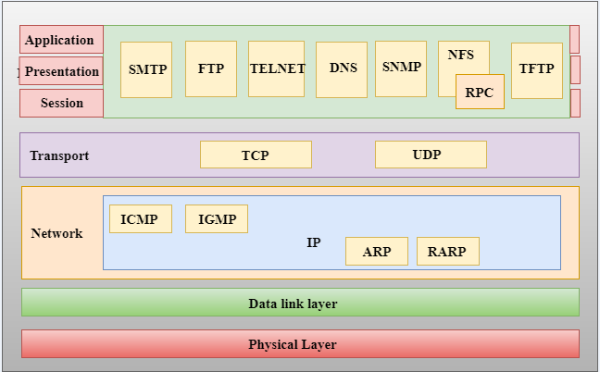
TCP/IP

